Slide 1
Unit 2
Stack and Queues

Slide 2
Stack and Queues
Linked List implementation of Stack
Linked List implementation of Queue
Circular Queue

Slide 3
Data Structure
A data structure is a storage that is used to store and organize data. It is a way of arranging data on a computer so that it can be accessed and updated efficiently.
A data structure is a specialized format for organizing, processing, retrieving and storing data.
Data structures make it easy for users to access and work with the data they need in appropriate ways.
Data structures frame the organization of information so that machines and humans can better understand it.

Slide 4
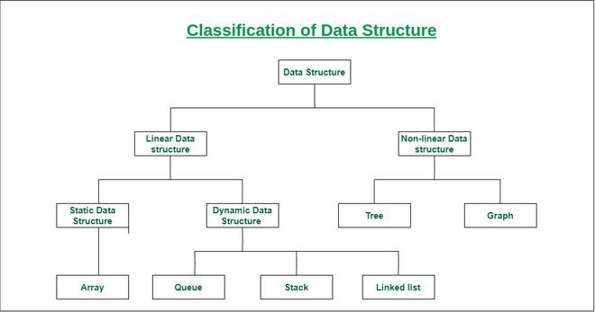
Classification of Data Structure

Slide 5
Linear data structure
Data structure in which data elements are arranged sequentially or linearly, where each element is attached to its previous and next adjacent elements, is called a linear data structure.
Examples of linear data structures are array, stack, queue, linked list, etc.

Slide 6
Linear data structure
Static data structure: Static data structure has a fixed memory size. It is easier to access the elements in a static data structure. An example of this data structure is an array.
Dynamic data structure: In dynamic data structure, the size is not fixed. It can be randomly updated during the runtime which may be considered efficient concerning the memory (space) complexity of the code. Examples of this data structure are queue, stack, etc.

Slide 7
Non Linear data structure
Non-linear data structure: Data structures where data elements are not placed sequentially or linearly are called non-linear data structures. In a non-linear data structure, we can’t traverse all the elements in a single run only. Examples of non-linear data structures are trees and graphs.

Slide 8
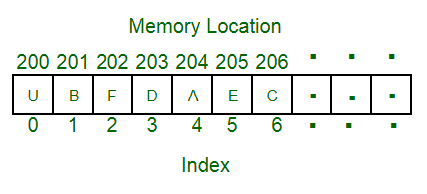
Linear data structure
For example, we can store a list of items having the same data-type using the array data structure.
Array Data Structure

Slide 9
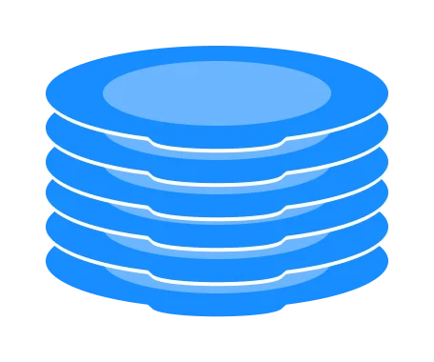
What is a Stack?
A Stack is a linear data structure that follows the LIFO (Last-In-First-Out) principle.
It contains only one pointer top pointer pointing to the topmost element of the stack. Whenever an element is added in the stack, it is added on the top of the stack, and the element can be deleted only from the stack.
In other words, a stack can be defined as a container in which insertion and deletion can be done from the one end known as the top of the stack.
You can think of the stack data structure as the pile of plates on top of another.
Here, you can:
Put a new plate on top
Remove the top plate

Slide 10
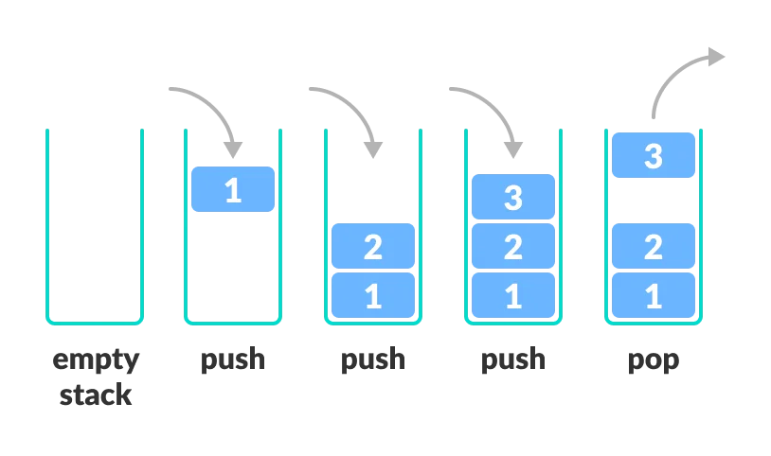
LIFO Principle of Stack
In the above image, although item 3 was kept last, it was removed first. This is exactly how the LIFO (Last In First Out) Principle works.

Slide 11
Basic Operations of Stack
There are some basic operations that allow us to perform different actions on a stack.
Push: Add an element to the top of a stack
Pop: Remove an element from the top of a stack
IsEmpty: Check if the stack is empty
IsFull: Check if the stack is full
Peek: Get the value of the top element without removing it

Slide 12
Working of Stack Data Structure
A pointer called TOP is used to keep track of the top element in the stack.
When initializing the stack, we set its value to -1 so that we can check if the stack is empty by comparing TOP == -1.
On pushing an element, we increase the value of TOP and place the new element in the position pointed to by TOP.
On popping an element, we return the element pointed to by TOP and reduce its value.
Before pushing, we check if the stack is already full
Before popping, we check if the stack is already empty

Slide 13
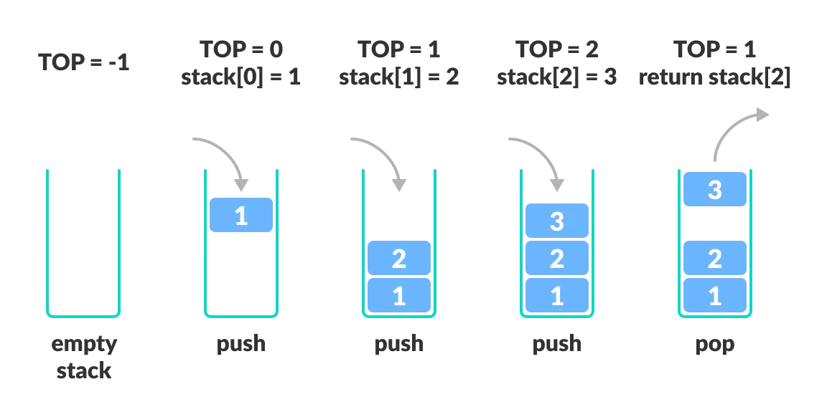
Working of Stack Data Structure
Working of Stack Data Structure

Slide 14
push() method
The push() method allows you to add one or more elements to the end of the array. The push() method returns the value of the length property that specifies the number of elements in the array.
push() method adds one or more element at the top of the stack. The following example creates an empty array named stack and adds five numbers, one by one, at the end of the stack array. It is like to push each number into the top of the stack.

Slide 15
Push Operation
Push operation involves a series of steps −
Step 1 − Checks if the stack is full.
Step 2 − If the stack is full, produces an error and exit.
Step 3 − If the stack is not full, increments top to point next empty space.
Step 4 − Adds data element to the stack location, where top is pointing.
Step 5 − Returns success.

Slide 16
Algorithm:
begin
if top = n then stack full
top = top + 1
stack (top) : = item;
end

Slide 17
implementation of push algorithm in C language
void push (int val,int n) //n is size of the stack
{
if (top == n )
printf("\n Overflow");
else
{
top = top +1;
stack[top] = val;
}
}

Slide 18
Deletion of an element from a stack (Pop operation)
Algorithm :
begin
if top = 0 then stack empty;
item := stack(top);
top = top - 1;
end;

Slide 19
Deletion of an element from a stack (Pop operation)
int pop () {
if(top == -1) {
printf("Underflow");
return 0; }
else
{ return stack[top - - ];
}
}

Slide 20
Visiting each element of the stack (Peek operation)
Peek operation involves returning the element which is present at the top of the stack without deleting it. Underflow condition can occur if we try to return the top element in an already empty stack.
Algorithm :
PEEK (STACK, TOP)
Begin
if top = -1 then stack empty
item = stack[top]
return item
End

Slide 21
Implementation of Peek algorithm in C language
int peek()
{ if (top == -1)
{ printf("Underflow");
return 0;
}
else
{ return stack [top];
}
}

Slide 22
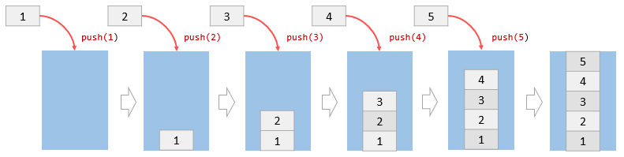
push() method using JavaScript
let stack = [];
stack.push(1);
console.log(stack); // [1]
stack.push(2);
console.log(stack); // [1,2]
stack.push(3);
console.log(stack); // [1,2,3]
stack.push(4);
console.log(stack); // [1,2,3,4]
stack.push(5);
console.log(stack); // [1,2,3,4,5]
Initially, the stack is empty. Each time, we call the push() method to add a number to the stack. After 5 calls, the stack has 5 elements

Slide 23
pop() method
The pop() method removes the element at the end of the array and returns the element to the caller. If the array is empty, the pop() method returns undefined.
.

Slide 24
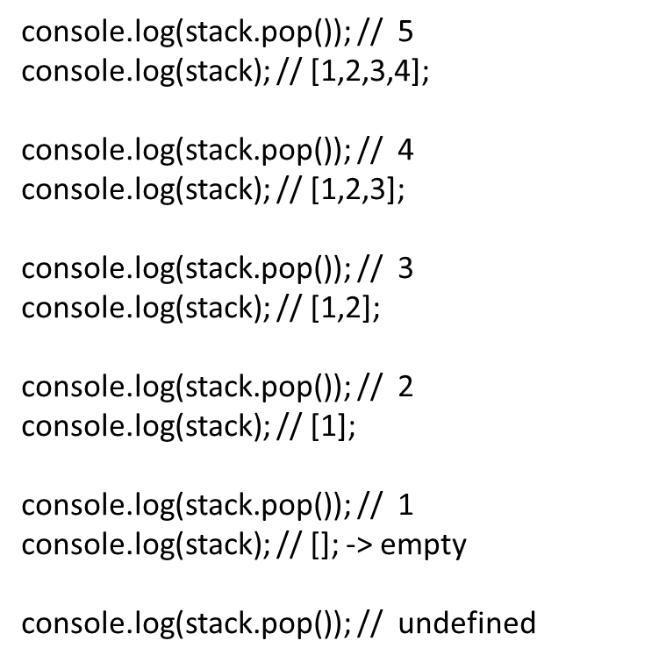
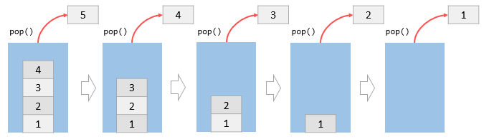
pop() method

Slide 25
isEmpty()
// isEmpty function
isEmpty()
{
// return true if stack is empty
return this.items.length == 0;
}
Returns true if the stack is empty.

Slide 26
printStack()
printStack() : This method returns a string in which all the element of an stack is concatenated. // printStack function
printStack()
{
var str = "";
for (var i = 0; i < this.items.length; i++)
str += this.items[i] + " ";
return str;
}

Slide 27
A Pop operation may involve the following steps −
Step 1 − Checks if the stack is empty.
Step 2 − If the stack is empty, produces an error and exit.
Step 3 − If the stack is not empty, accesses the data element at which top is pointing.
Step 4 − Decreases the value of top by 1.
Step 5 − Returns success.

Slide 28
Declaring a class
Class stack is declared to initialize an array that will be used to store items of the stack:
class Stack { constructor() { this.items = []; } }

Slide 29
Push an item
Adds an item in the stack:
push(element) { this.items.push(element); }

Slide 30
Pop an item
Removes the last item added in the stack
pop() { if (this.items.length == 0) return "Underflow"; return this.items.pop(); }

Slide 31
Peek
Returns the last item that was pushed in the stack:
peek() { this.items[this.items.length - 1]; }

Slide 32
isEmpty
Tells whether or not the stack is empty:
isEmpty() { return this.items.length == 0; }

Slide 33
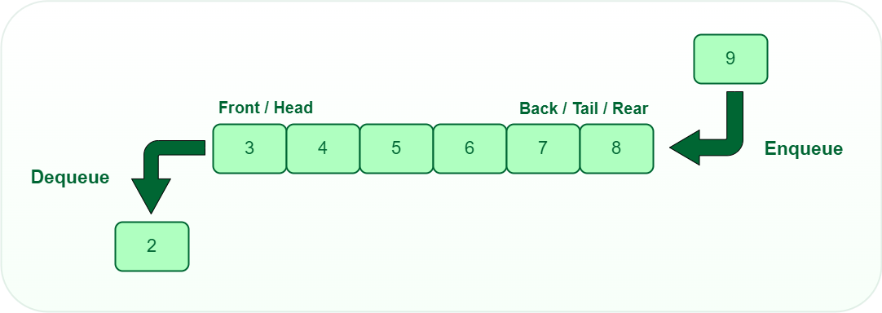
QUEUE
What is Queue?
A queue is defined as a linear data structure that is open at both ends and the operations are performed in First In First Out (FIFO) order.
a queue to be a list in which all additions to the list are made at one end, and all deletions from the list are made at the other end. .

Slide 34
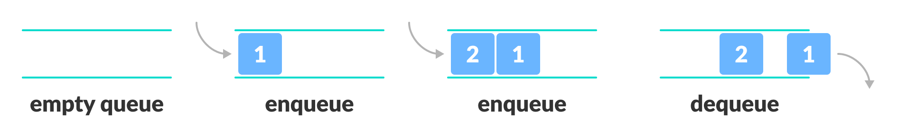
Queue
A queue is a useful data structure in programming. It is similar to the ticket queue outside a cinema hall, where the first person entering the queue is the first person who gets the ticket.
Queue follows the First In First Out (FIFO) rule - the item that goes in first is the item that comes out first.
1 was kept in the queue before 2, it is the first to be removed from the queue as well. It follows the FIFO rule.
Putting items in the queue is called enqueue, and removing items from the queue is called dequeue.

Slide 35
Basic Operations of Queue
A queue is an object (an abstract data structure - ADT) that allows the following operations:
Enqueue: Add an element to the end of the queue
Dequeue: Remove an element from the front of the queue
IsEmpty: Check if the queue is empty
IsFull: Check if the queue is full
Peek: Get the value of the front of the queue without removing it

Slide 36
Working of Queue
Queue operations work as follows:
two pointers FRONT and REAR
FRONT track the first element of the queue
REAR track the last element of the queue
initially, set value of FRONT and REAR to -1

Slide 37
peek()
This function helps to see the data at the front of the queue. The algorithm of peek() function is as follows −
Algorithm
begin procedure peek
return queue[front]
end procedure
Implementation of peek() function in C programming language −
Example
int peek() {
return queue[front];
}

Slide 38
isfull()
Single dimension array to implement queue, we just check for the rear pointer to reach at MAXSIZE to determine that the queue is full.
Algorithm
begin procedure isfull
if rear equals to MAXSIZE
return true
else
return false
endif
end procedure
Implementation of isfull() function in C programming language −
Example
bool isfull() {
if(rear == MAXSIZE - 1)
return true;
else
return false;
}

Slide 39
isempty()
Algorithm of isempty() function −
Algorithm
begin procedure isempty
if front is less than MIN OR front is greater than rear
return true
else
return false
endif
end procedure
bool isempty() {
if(front < 0 || front > rear)
return true;
else
return false;
}

Slide 40
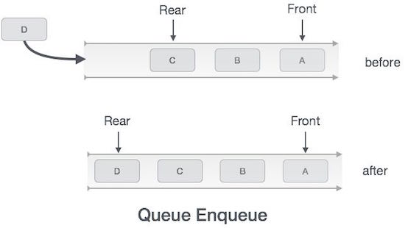
Enqueue Operation
check if the queue is full
for the first element, set the value of FRONT to 0
increase the REAR index by 1
add the new element in the position pointed to by REAR

Slide 41
Enqueue Operation
Algorithm for enqueue operation
procedure enqueue(data)
if queue is full
return overflow
endif
rear ← rear + 1
queue[rear] ← data
return true
end procedure

Slide 42
Implementation of enqueue() in C programming language −
int enqueue(int data)
if(isfull())
return 0;
rear = rear + 1;
queue[rear] = data;
return 1;
end procedure

Slide 43
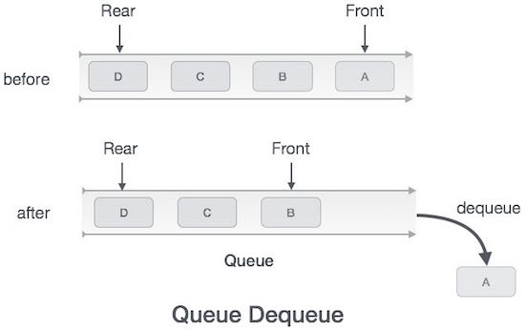
Dequeue Operation
check if the queue is empty
return the value pointed by FRONT
increase the FRONT index by 1
for the last element, reset the values of FRONT and REAR to -1

Slide 44
procedure dequeue
if queue is empty
return underflow
end if
data = queue[front]
front ← front + 1
return true
end procedure

Slide 45
Implementation of dequeue() in C programming language −
int dequeue() {
if(isempty())
return 0;
int data = queue[front];
front = front + 1;
return data;
}

Slide 46
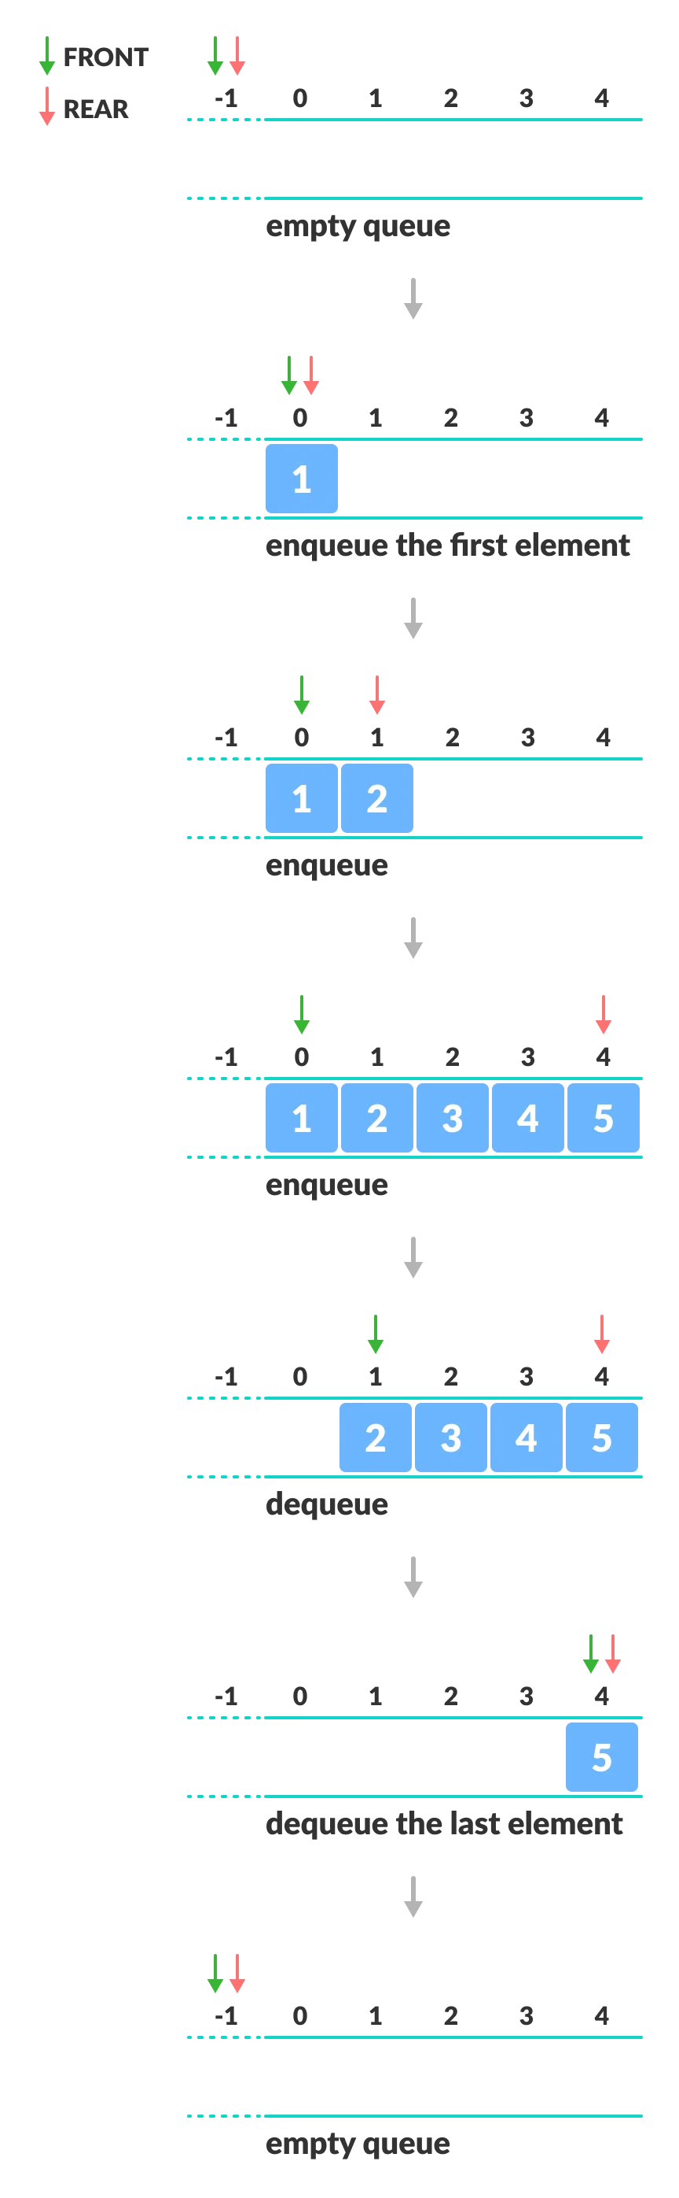
For example

Slide 47
Applications of Queue
CPU scheduling, Disk Scheduling
When data is transferred asynchronously between two processes.The queue is used for synchronization. For example: IO Buffers, pipes, file IO, etc
Handling of interrupts in real-time systems.
Call Center phone systems use Queues to hold people calling them in order.

Slide 48
Types of Queues
A queue is a useful data structure in programming. It is similar to the ticket queue outside a cinema hall, where the first person entering the queue is the first person who gets the ticket.
There are four different types of queues:
Simple Queue
Circular Queue
Priority Queue
Double Ended Queue

